Slide 1


The Primary Function of MTL is Memory, not Navigation: Grid Cells are Non-spatial (what) and Place Cells are Memories (what and where) that Cause Grid Fields through Retrieval
David E. Huber
Department of Psychology and Neuroscience
University of Colorado Boulder
Cognitive Experiments, Models, and Neuroscience Lab
Huber (2024) eLife
Notes:
Frequently, presenters must deliver material of a technical nature to an audience unfamiliar with the topic or vocabulary. The material may be complex or heavy with detail. To present technical material effectively, use the following guidelines from Dale Carnegie Training®.
Consider the amount of time available and prepare to organize your material. Narrow your topic. Divide your presentation into clear segments. Follow a logical progression. Maintain your focus throughout. Close the presentation with a summary, repetition of the key steps, or a logical conclusion.
Keep your audience in mind at all times. For example, be sure data is clear and information is relevant. Keep the level of detail and vocabulary appropriate for the audience. Use visuals to support key points or steps. Keep alert to the needs of your listeners, and you will have a more receptive audience.

Slide 2
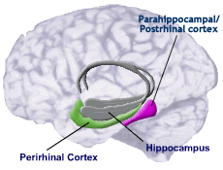
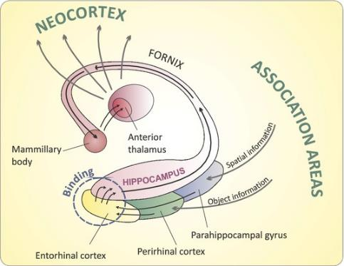
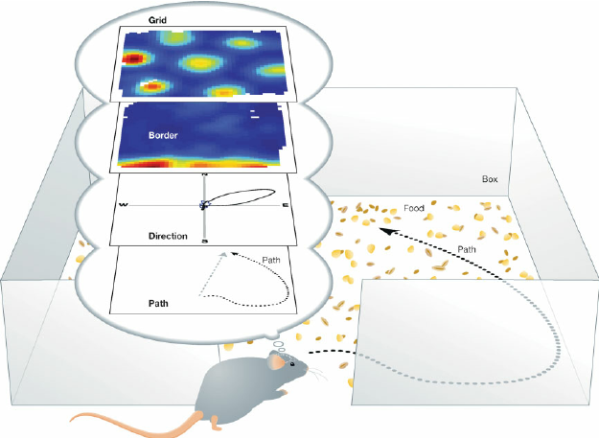
What is the function of the medial temporal lobe?
Spatial Navigation
Episodic Memory
Hippocampal place cells
Entorhinal cells
border cells
head direction cells
grid cells
head direction grid cells
Anterograde amnesia and hippocampal damage
Parahippocampus and episodic familiarity
Perirhinal and object familiarity

Slide 3
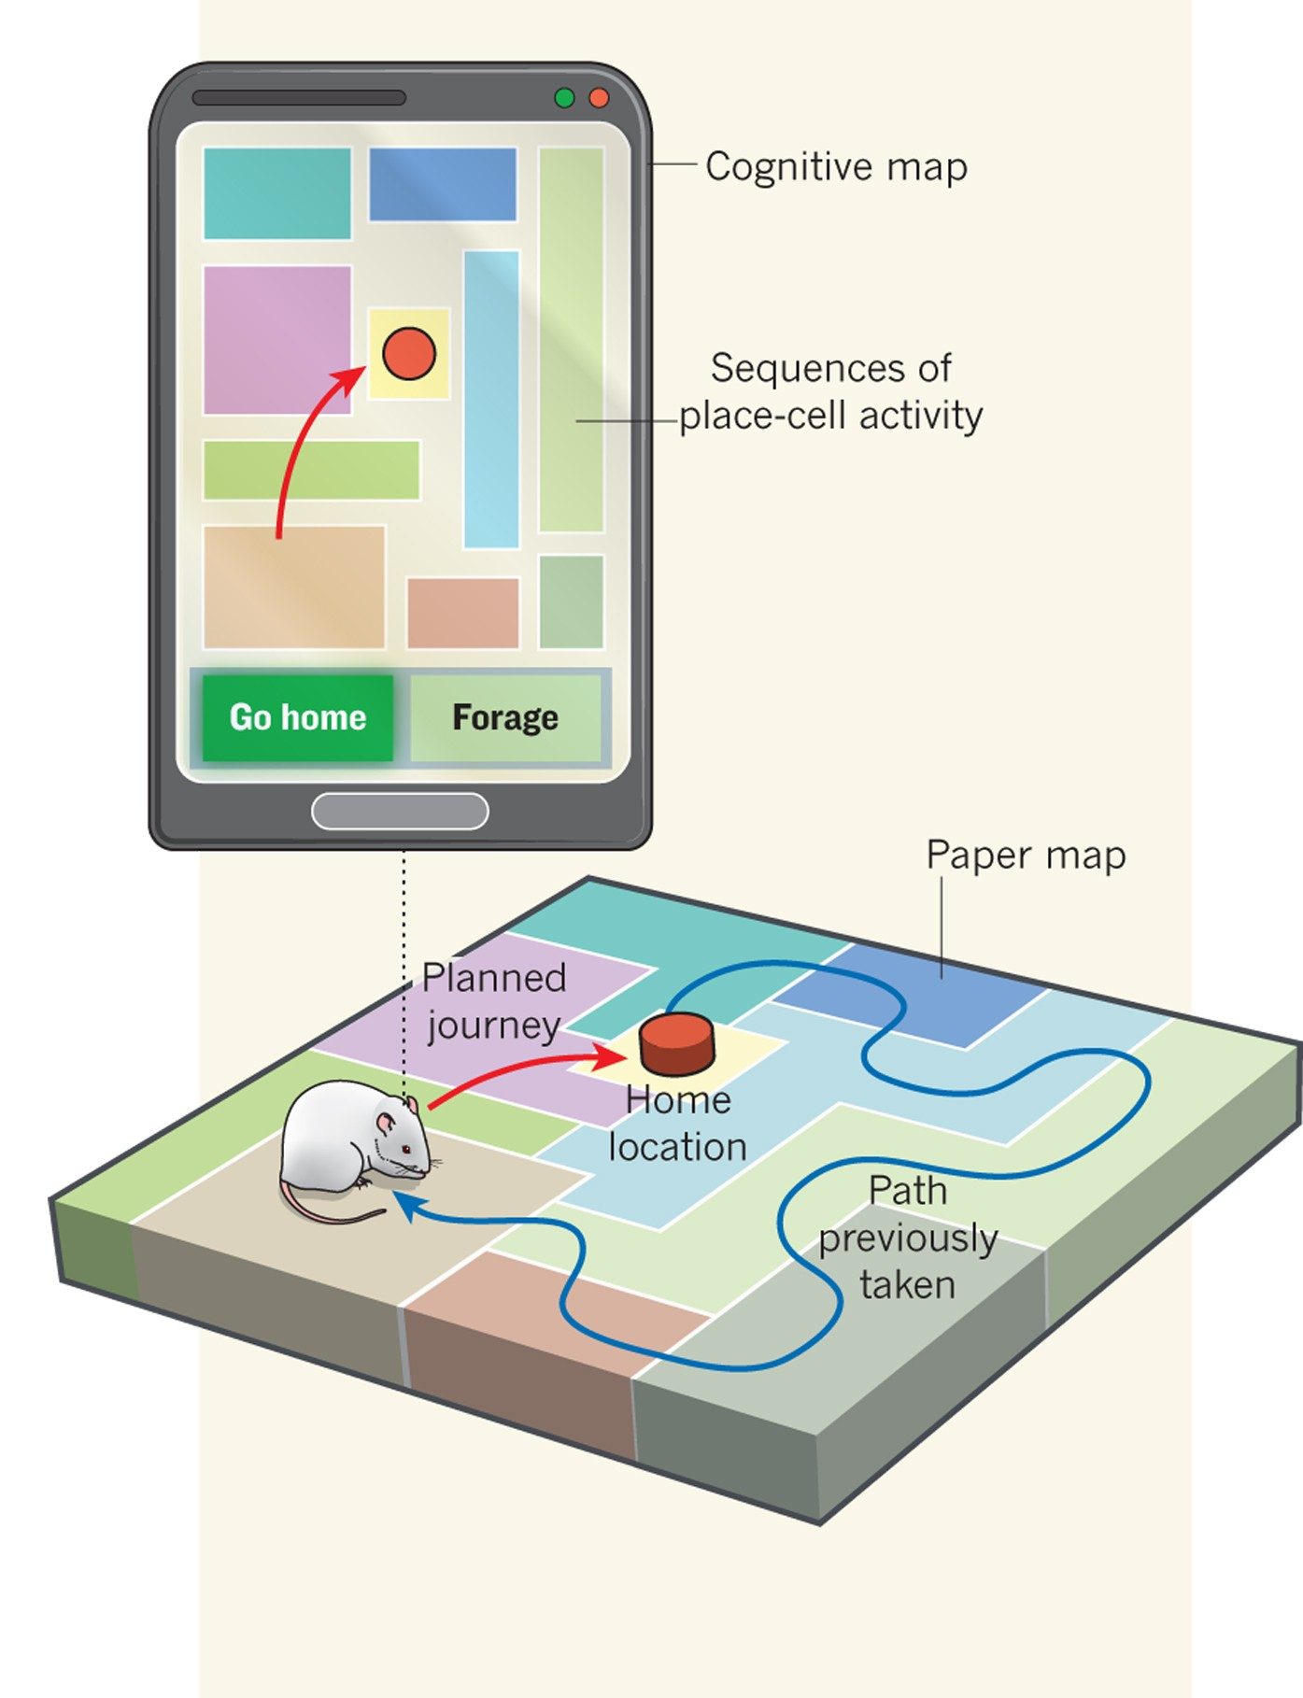
Spatial Navigation is a Memory Task
A ‘cognitive map’ is something that is learned
Animals needs to remember what is located where (a conjunction)
This perspective does NOT say anything about
Phylogeny: perhaps MTL evolved for spatial navigation and was later co-opted for memory
Ontogeny: perhaps spatial navigation ability occurs earlier in development
Locations can trigger memory retrieval
New interpretation of ‘place field’

Slide 4

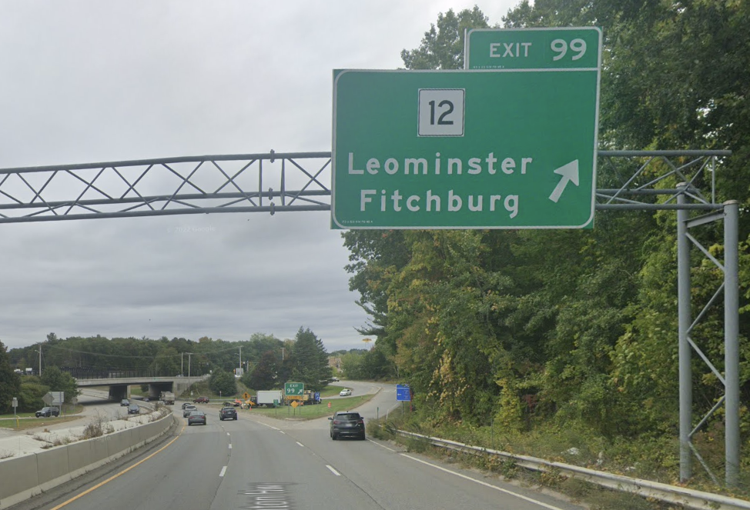
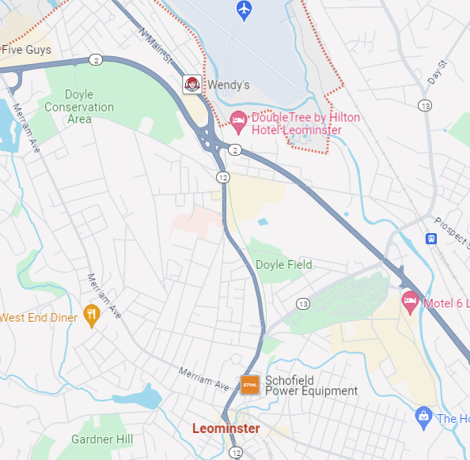
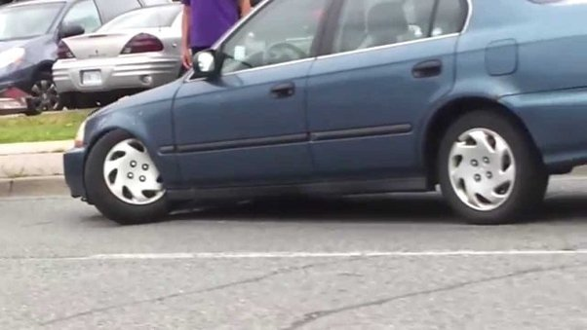
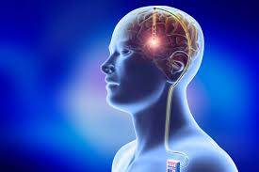
Memory Retrieval and Place Cells: My 18th Birthday

Slide 5
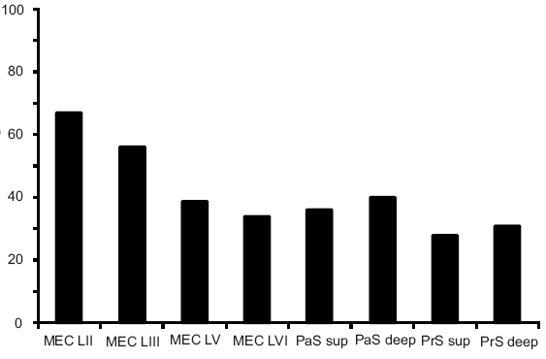
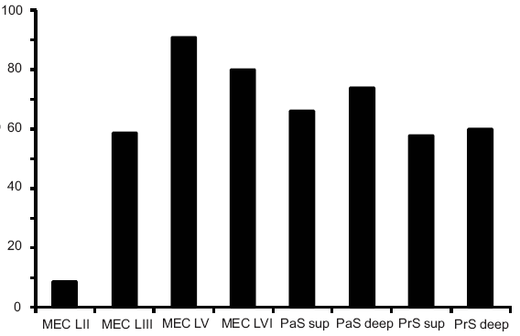
Most Cells in the Entorhinal Cortex appear to be Spatial
But how can this be if the HPC encodes memories?
Hippocampus
PrS
PaS
MEC
Border cells
Grid cells
% of grid cells that are also HD
% of population
MEC
PaS
PrS
MEC
PaS
PrS
MEC
PaS
PrS
Boccara et al (2010) Nature Neuroscience
Notes:
In a sense we have only moved the question one synapse upstream. How is the spatial signal produced in the entorhinal cortex?
Suggesting that the particular network architecture is possibly not the cruicial factor

Slide 6

What if grid cells are not spatial? (memory retrieval in specific locations)
Place Cells (memory for what and where)
Equally Dissimilar Memories
mEC Grid Cell
(non-spatial what found everywhere in box)
CAN A MEMORY MODEL EXPLAIN THE RODENT SPATIAL NAVIGATION DATA?

Slide 7
What is the Function of Grid Cells?
Represent attributes common to entire recording session/box
Odor, lighting, surfaces, etc.
Fear, wires-attached, electronic sounds, etc.
Attributes remembered in a grid because these non-spatial properties are found everywhere in the recording enclosure
In the typical navigation experiment, memories differ from each other only in terms of space
Equal spacing of place cell memories is an artifact of a well-controlled, non-ecological enclosure
No landmarks or other forms of variation
But why wouldn’t the grid cell fire everywhere in the box?
Neurons accommodate and are more likely to fire with strong top-down feedback

Slide 8
Network Architecture
MEMORIES: Place Cells (places where k is found)
p₁
p₂
p₃
p₄
p₅
p₆
p₇
p₈
p₉
. . .
W_{1j}
e₁
e₂
e₃
f₁
f₂
f₃
g₁
g₂
g₃
h₁
h₂
h₃
k
WHERE: Border Cells (distances to borders)
Head
Direction
WHAT: Grid Cell

Slide 9
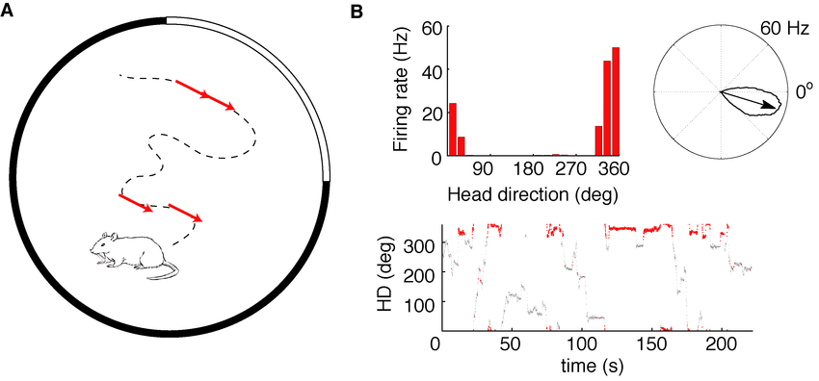
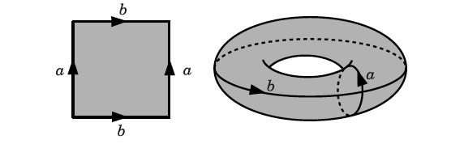
Head Direction is Circular (for simplicity, assume X/Y are also circular)
Gardner et al. (2022) Nature

Slide 10
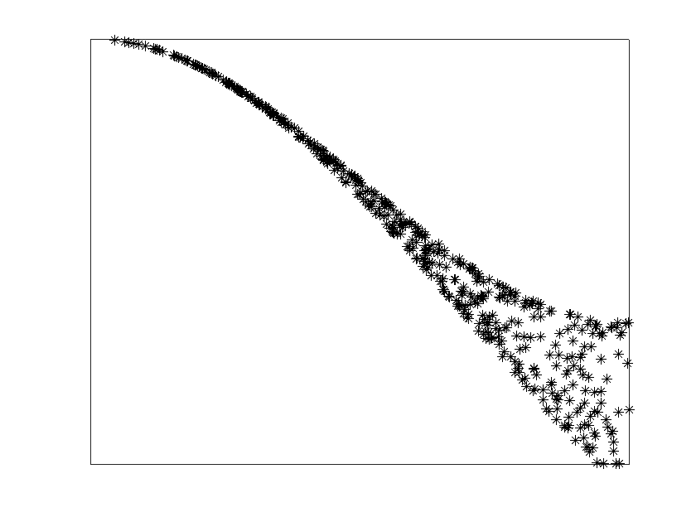
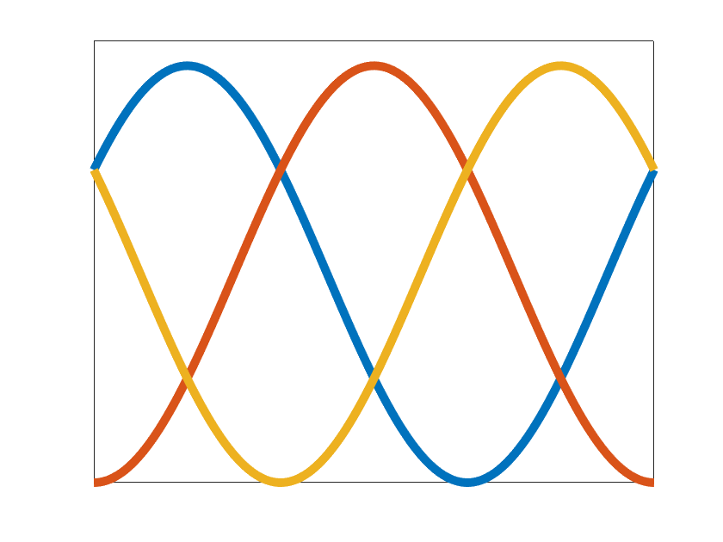
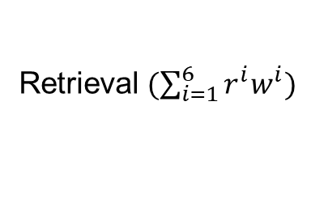
Memory Retrieval and Distance
Retrieval $(\sum_{i=1}^{6}{r^{i}w^{i}})$
Y
memory
position
w₆
w₄
w₅
distance
circular
wraparound
seams
Retrieval
r₄
r₆
r₅
current
position
-1
0
+1
0
distance
1
w₂
r₂
w₁
X
r₃
w₃
r₁

Slide 11
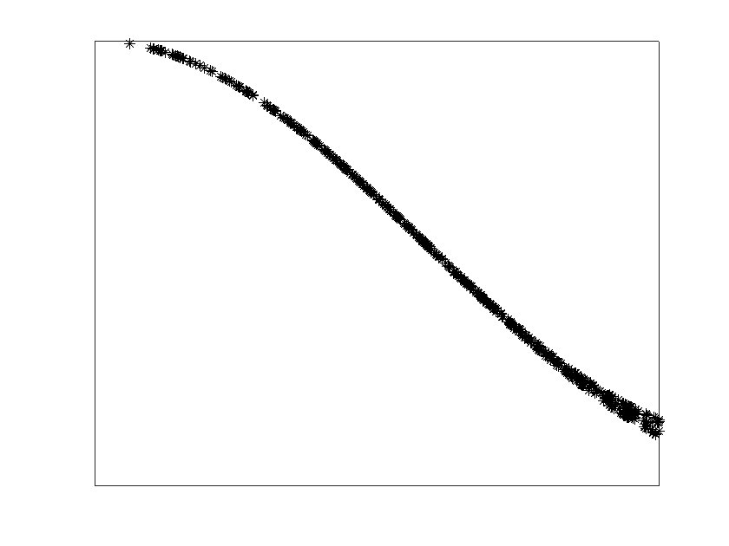
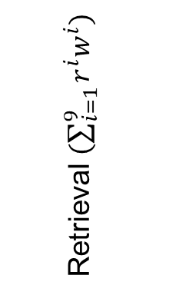
Memory Retrieval on a ‘3-torus’ Produces Euclidean Distances
F
Retrieval $(\sum_{i=1}^{9}{r^{i}w^{i}})$
G
circular
wraparound
seams
0
distance
1
E

Slide 12
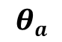
A Retrieval Threshold for Learning
k odor here too
k odor here
$$θa$$
Memory Encoding

Slide 13
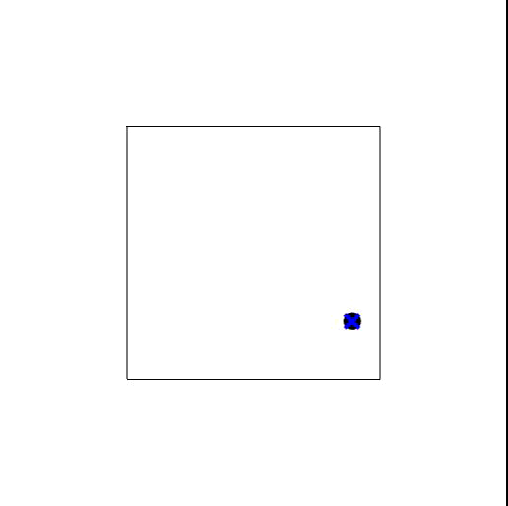
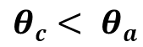
Online Memory Consolidation
$$θc< θa$$
retrieved
memory
Δw
current
position
too close
too far
THE RETRIEVED MEMORY IS ADJUSTED TO BE
EQUALLY SIMILAR/DISSIMILAR TO COMPETING MEMORIES

Slide 14
Border Cells
g₃
f₁
Southwest
corner
between
SW and NE
Northeast
corner
Northwest
corner
between
NW and SE
Southeast
corner
g₂
f₂
g₁
f₃
circular
wraparound
seams
preferred
positions of
border cell
e₁
e₂
e₃
outside
West wall
between
West/East
outside
East wall

Slide 15



Grid Spacing Depends on Consolidation Threshold
novel
familiar
novel
familiar
novel
familiar
Sim #1
Sim #2
Sim #3
Sim #4
$$θc= .75$$
$$θc= .8$$
$$θc= .9$$
Sparse Memories
Densely Packed Memories

Slide 16
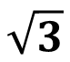
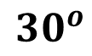
Grid Modules: Scale and Orientation Co-vary
$$\sqrt{3}$$
$${30}^{o}$$
Stensola, Stensola, Solstad, Froland, Moser and Moser (2012) Nature

Slide 17
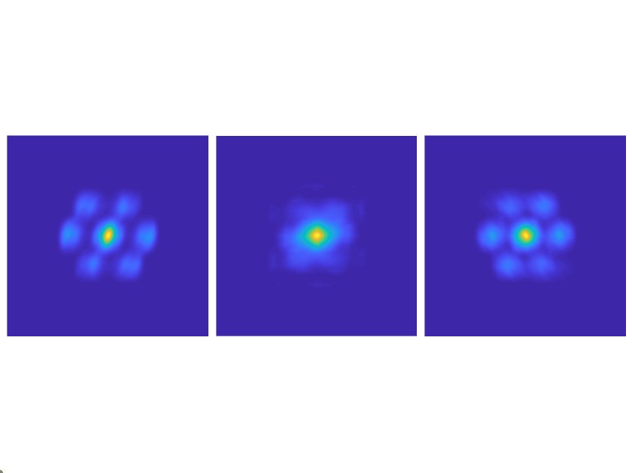
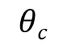
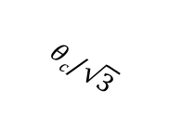
‘Grid Module’ when including head direction (face-centered cubic packing)
k
h₁
h₂
h₃
Set of Place Cells
Set of Place Cells
allocentric
$$θc\text{/}\sqrt{3}$$
h₃
$$θc$$
Y dimension
h₂
HD dimension
allocentric
HD dimension
h₁
Y dimension
X dimension
X dimension

Slide 18

Place Cells take longer to Stabilize
Grid Cell (k)
HD Grid Cell (h_{max})
Grid Score
# of Place Cells
Sessions of Prior Experience
STABILITY DEPENDS ON LEARNING MANY VIEWS OF BOUNDARIES

Slide 19
Results Explained by Memory Model
the population code of grid cells lies on a torus
grid fields can be centered outside the box
grid is aligned with the walls of the box
the immediate existence of the grid pattern
the slower learning of place fields
dependency of grid cells on hippocampal feedback
grid cell modules
HD grid cells become head direction cells w/o hippocampal feedback
grid cells that are also sensitive to sound frequency
hexagonal grid patterns for non-spatial representations
grid pattern is disrupted in narrow passages
partial versus global remapping of place cells
place cell head direction sensitivity depends on distance to place center
place cell head direction sensitivity increases in narrow passages

Slide 20
Model Predictions
place cells are arrayed in a grid
grid cells have non-spatial bottom-up receptive fields
grid cells revert to bottom-up receptive field w/o hippocampal feedback
place cells at same location have complementary head direction
stabilization of place fields depends on view-specific learning of borders
memories rapidly consolidate to become neither too similar nor too dissimilar
a naturalistic, cluttered enclosure will disrupt regularity of grid
Ginosar, Aljadeff, Las, Derdikman, & Ulanovsky (2023) Neuron

Slide 21
Conclusions
A unified model of spatial and memory representations in the medial temporal lobe
memories are conjunctions of what and where
Locations can trigger memory retrieval (i.e., remembering the attributes of that location)
place cells are memory cells
grid cells are the attributes at that location
Memories are modified to be equally similar/dissimilar
In an uncluttered environment, this produces hexagonal tiling of memories
This unified model should also be able to explain learning and memory effects more broadly
This is not just a grid cell model

Slide 22
Thanks!

Slide 23



Circular Box
novel
familiar
novel
familiar
novel
familiar
Sim #1
Sim #2
Sim #3
Sim #4
$$θc= .75$$
$$θc= .8$$
$$θc= .9$$

Slide 24
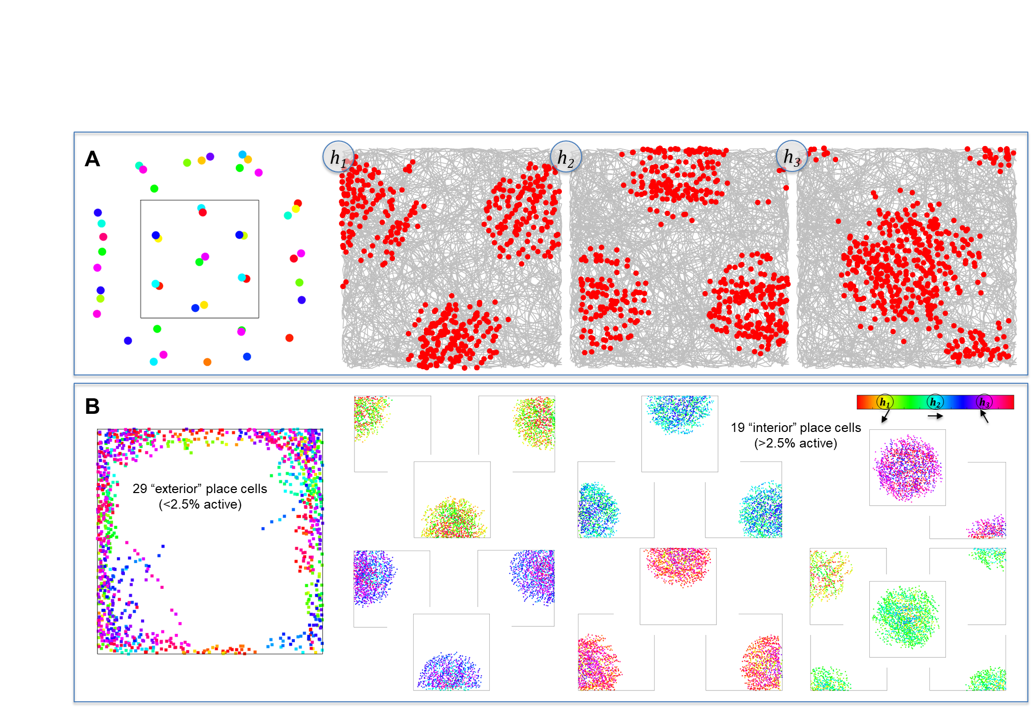
Exterior/Interior Place Cells

Slide 25
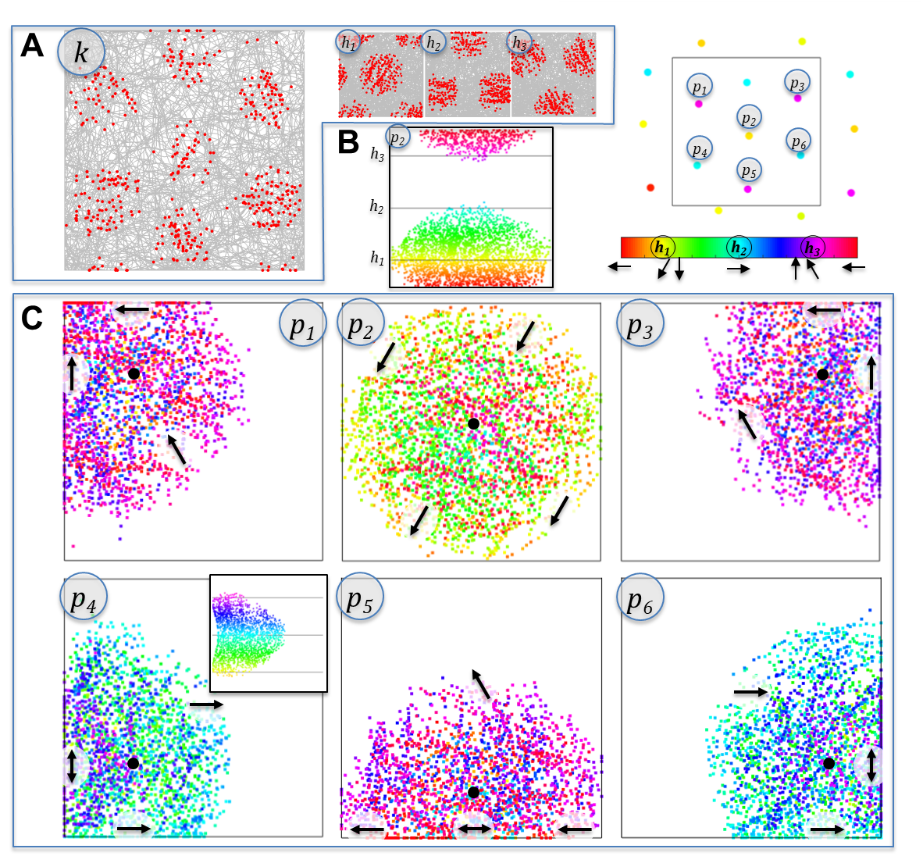
Head Direction Sensitivity of Place Cells Depends on Position

Slide 26
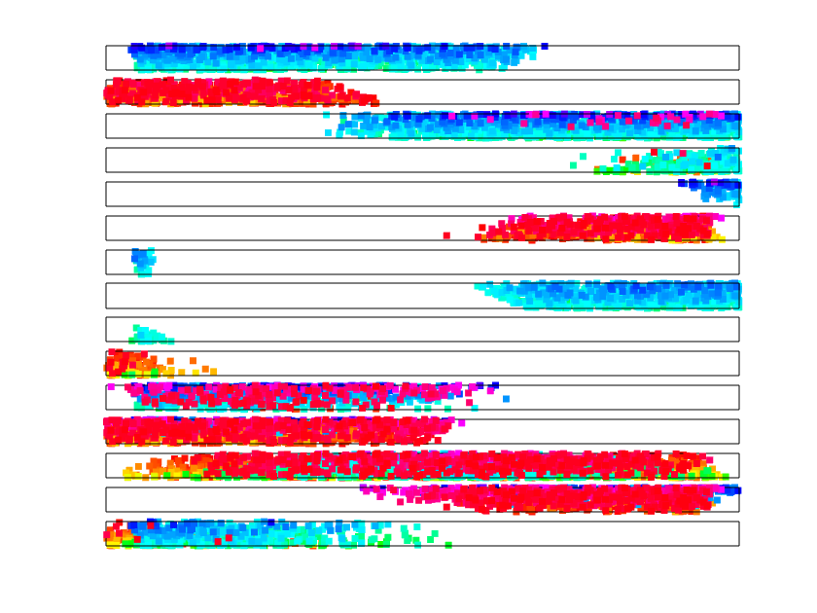
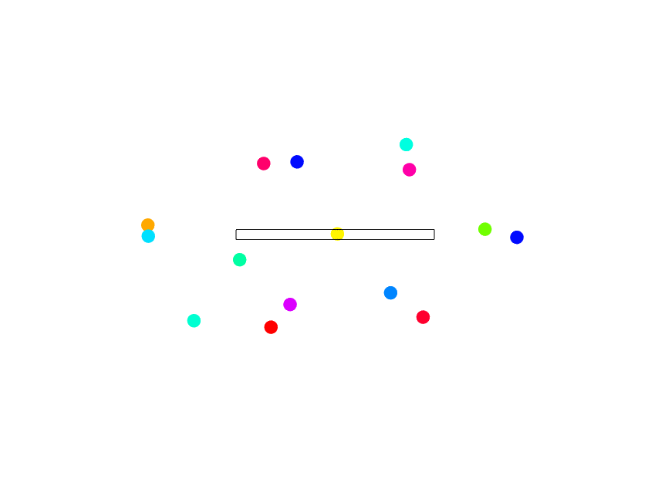
Head Direction Sensitivity of Place Cells in Narrow Passage
A
B

Slide 27
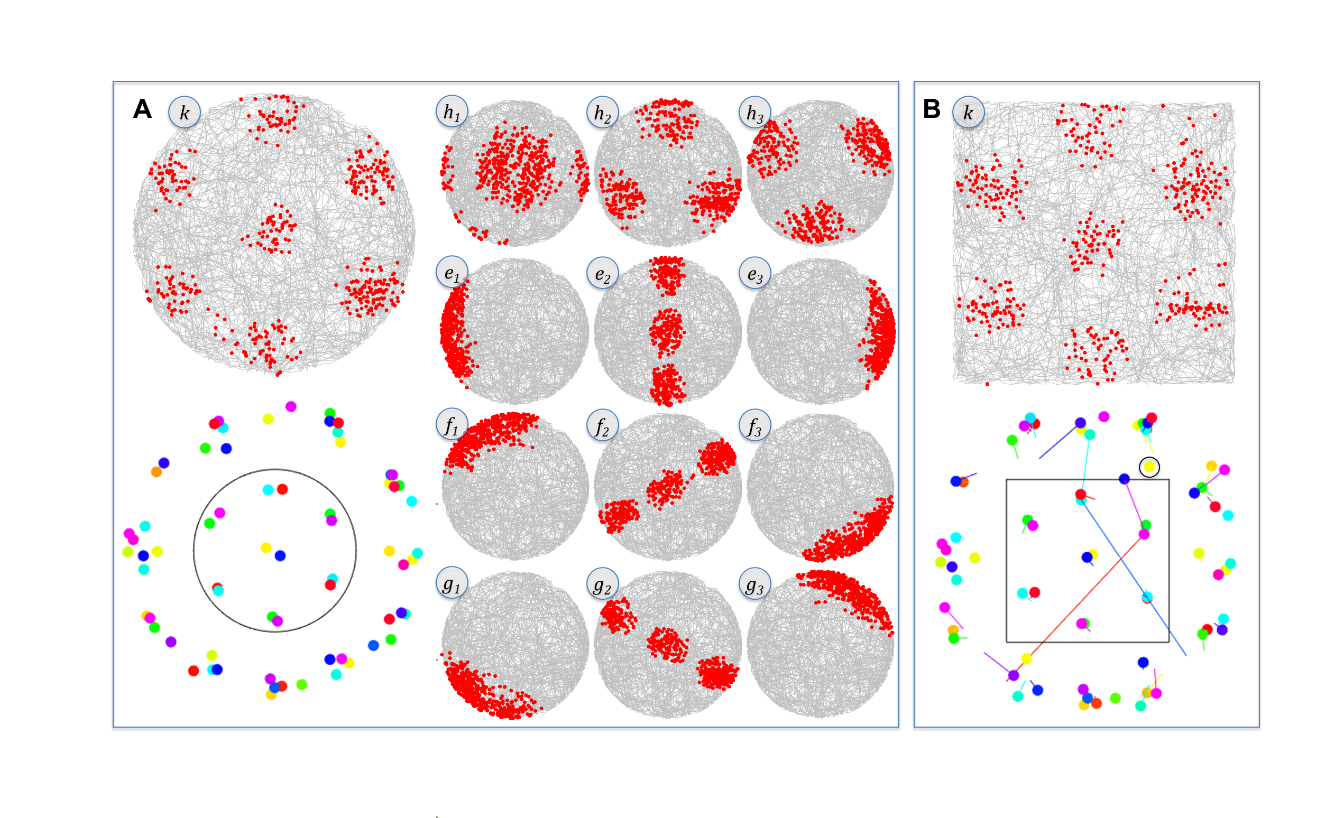
Remapping: Small Change

Slide 28
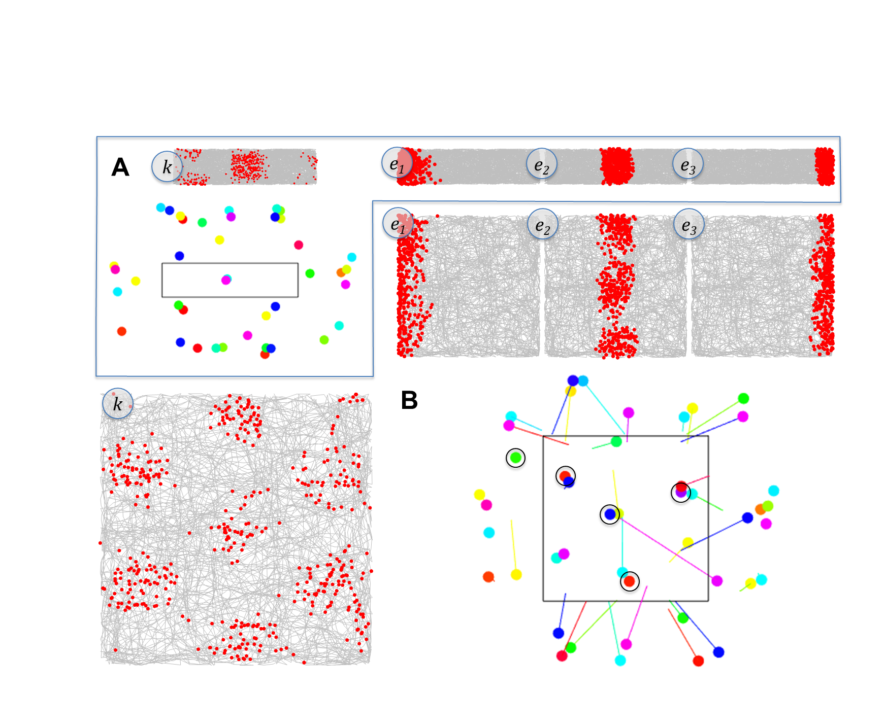
Remapping: Larger Change

Slide 29
Constantinescu, O’Reilly, & Behrens (2016) Science

